Slide 1
Marketing & Retail Analytics Project
Name: Abheer Bandodker
Batch No. : May 2019
BABI Programme

Slide 2
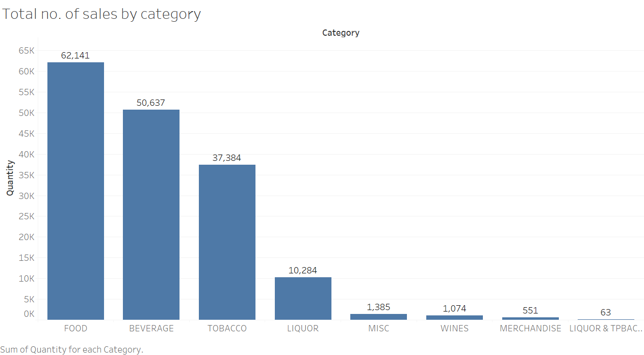
Exploratory Data Analysis
Food category is most widely bought category among all, followed by beverage, tobacco and liquor
MISC, wines and merchandise have very been very rarely bought as compared to their other mainstream counterparts
RECOMMENDATION: According to the analyst, may remove items within these categories as they may take up inventory space, if they don’t generate enough sales

Slide 3
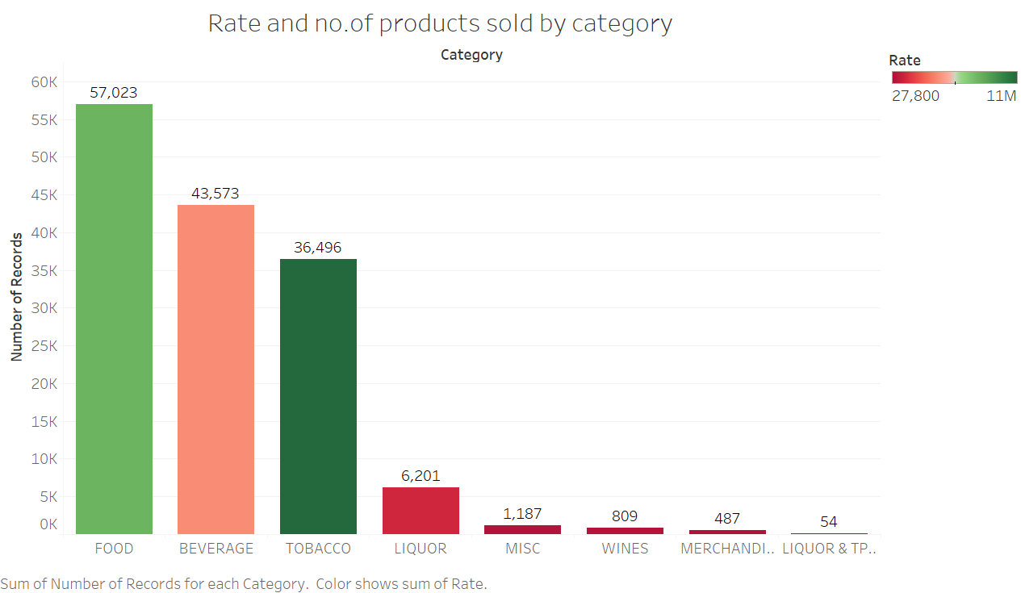
Rate and no. of Products sold by category
Food category has maximum number of products sold among all the categories
However, the tobacco category is the most highly priced
The beverage category has neither the most highly priced nor has the most number products sold

Slide 4
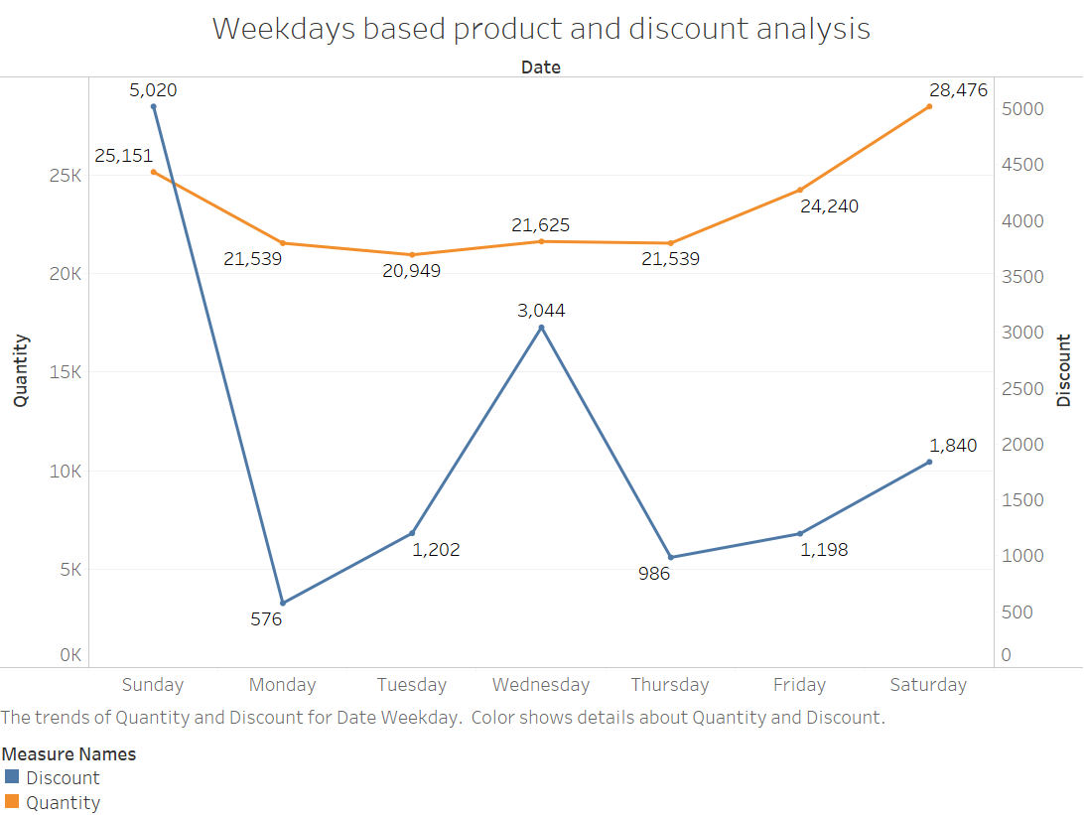
Weekdays based product and discount analysis
As depicted in the chart the product sales during the mid of the week decreases
The mid of the week also shows a erratic rise in the amount of discount provided to the customers
RECOMMENDATION: According to the analyst, it would be recommended to offer product combos to during this time period to normalize the sales

Slide 5
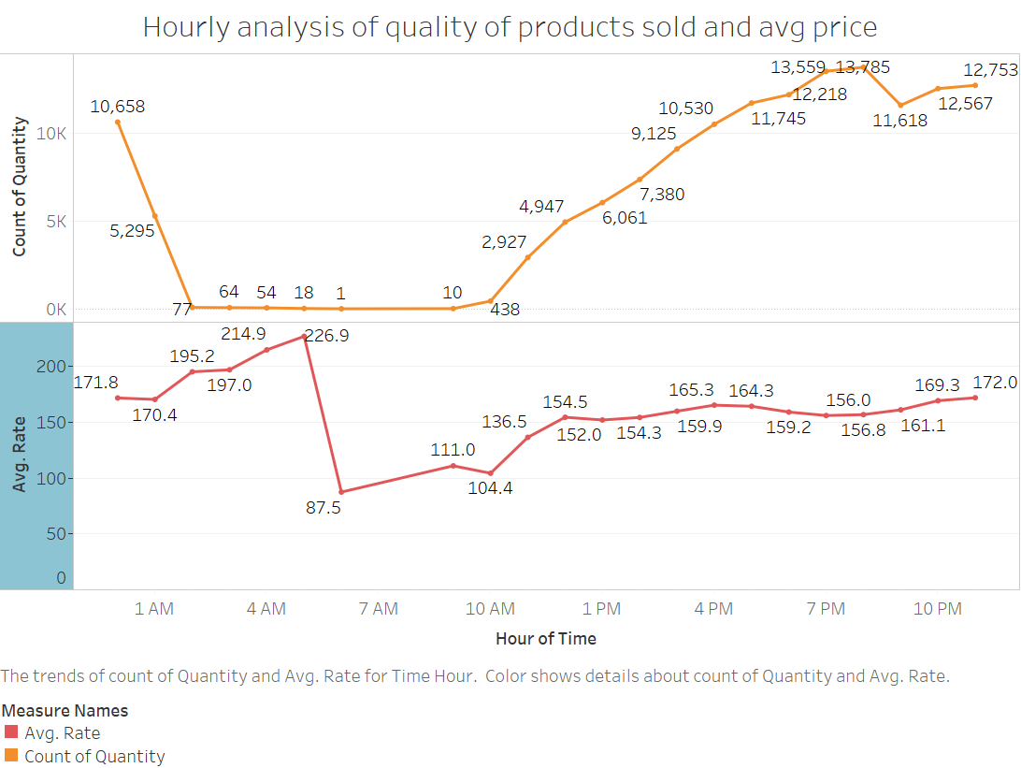
Hourly analysis of quality of products sold and avg price
The no. of products sold between 1 am to 10 am are low compared to other hours of the day
The avg. price of the products sold during these hours is also comparatively higher
RECOMMENDATION: During period of low sales the establishment should lower the price of products sold as it would encourage customers to purchase during these hours. It would further provide the establishment with the opportunity to cross-sell other products in the form of combos to boost sales

Slide 6
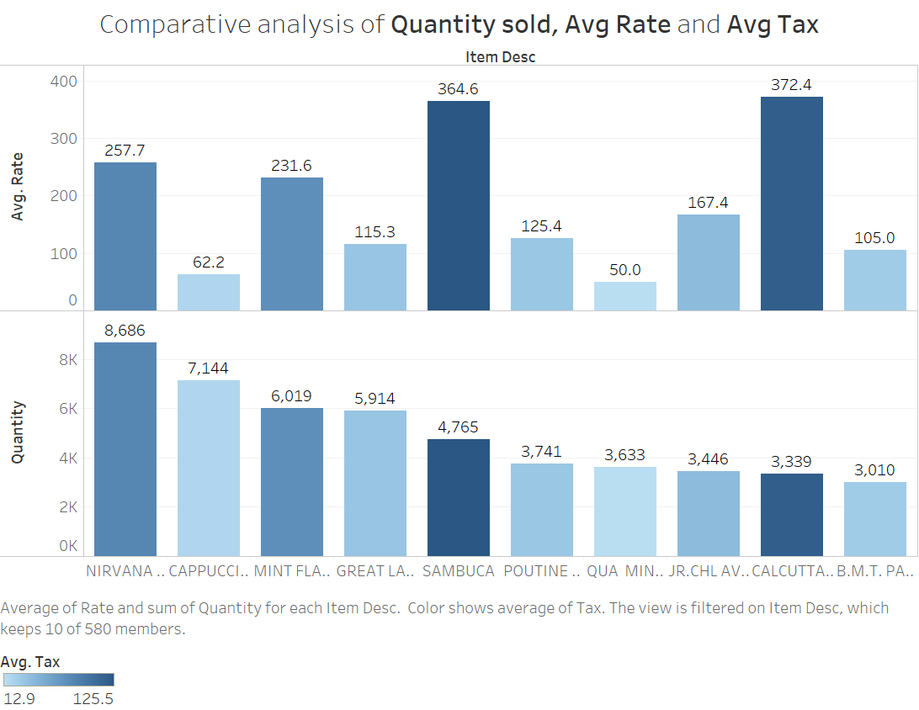
Comparative analysis of Quantity sold, Avg Rate and Avg Tax
The chart depicts the comparative analysis of top 10 items sold based on quantity, avg. rate and avg. tax
According to the graph the Nivana hookah single is the most frequently sold product, followed by cappuccino, mint flavour single and great lake shake
RECOMMENDATION: As items such as cappuccino, great lake shake and qua mineral water have low average price and are simultaneously sold is large qualities they are great products to provide in the form of combos during sales slump hours to trigger sales, thereby normalizing the sales during these hours

Slide 7
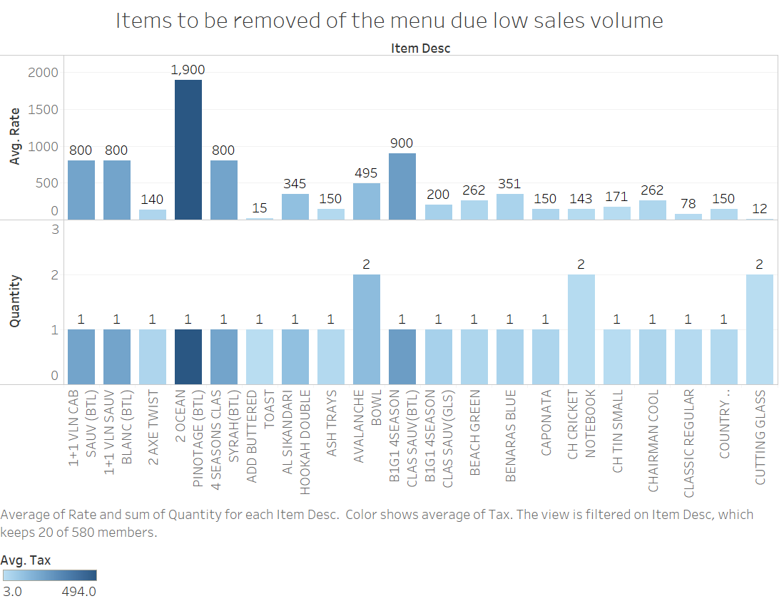
Items to be removed of the menu due low sales volume
RECOMMENDATION: The following items need to be removed from the menu as they are extremely low sales volume. The space and capital used to buy these items can be used to buy other items better utilizing the capital involved

Slide 8
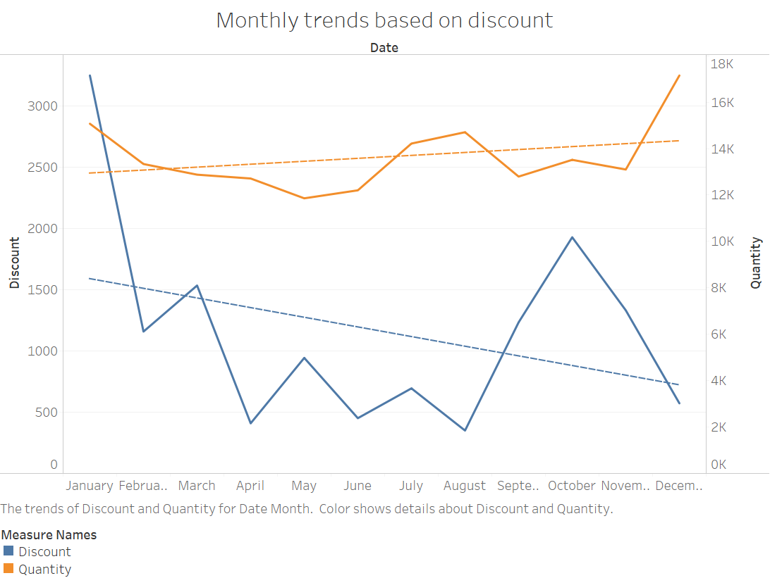
Monthly trends based on discount
The month of January experiences high sales mostly triggered due to heavy discounts
The subsequent months experience a decline in discounts offered. These slumps in sales can be attributed to certain external factors such as climatic changes or introduction of entry of various competitive forces in the market. The data provided is mostly restricted to a single year limiting the predictive capability of the data.

Slide 9
Analysing trends associated with different categories across months

Slide 10
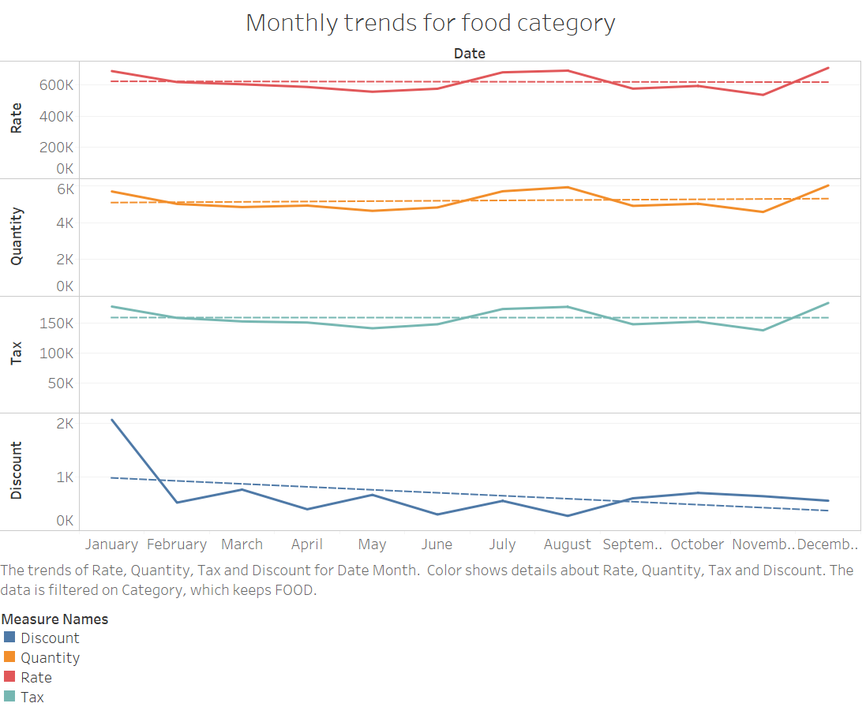
Monthly trends for food category
The food category experiences a very robust demand across the year
The rate/price, quantity of products sold and tax levied are comparatively stable
However, the month of January and February have high discount offered. This explains slight rise during these months in sales as depicted in the above quantities. Over the course of the year the discount falls gradually.

Slide 11
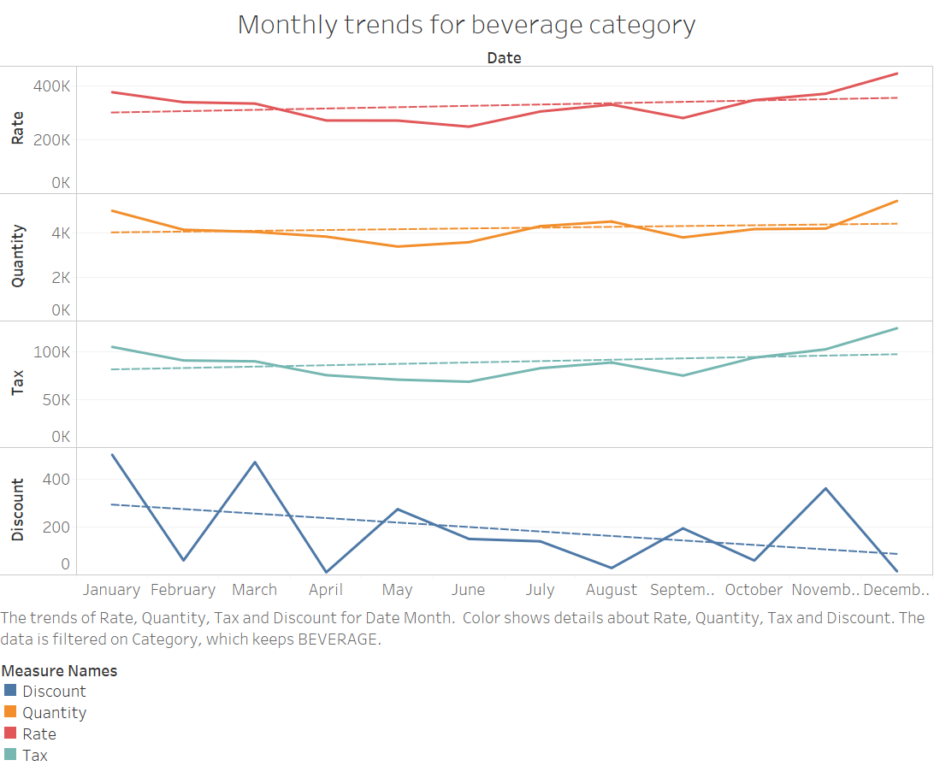
Monthly trends for beverage category
The rate/price of the beverage commodity experiences a gradual increase over the course of the year
The tax and quantity of the beverages sold are relatively stable. This depicts that the beverage category Is comparatively unaffected by external factors.
The discount experiences a steep fall over the year. However, there are certain sharp spikes and downturns over the year. These changes can be attributed to numerous seasonal changes or fluctuations. It can be also related to changes in customer preferences.

Slide 12
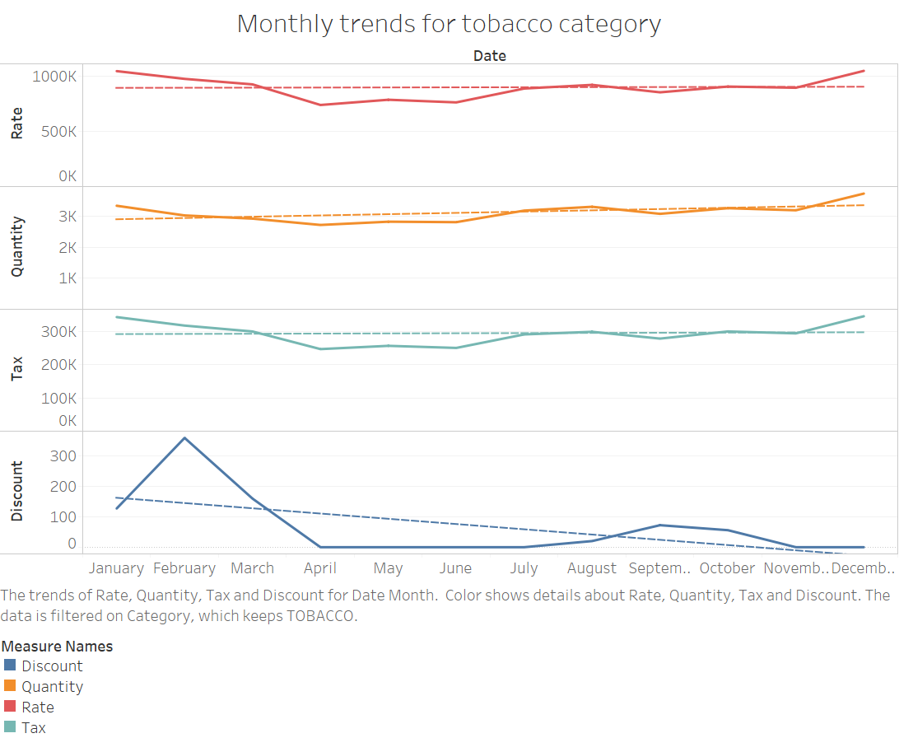
Monthly trends for tobacco category
The rate, quantity and tax are relatively robust without any significant fluctuations over the course of the year
The discount experiences a very steep decline over the course of year
This can be attributed to certain external factors such as increasing popularity of the establishment. It also shows that need to encourage customer purchases through discount slowly decreases over the year.

Slide 13
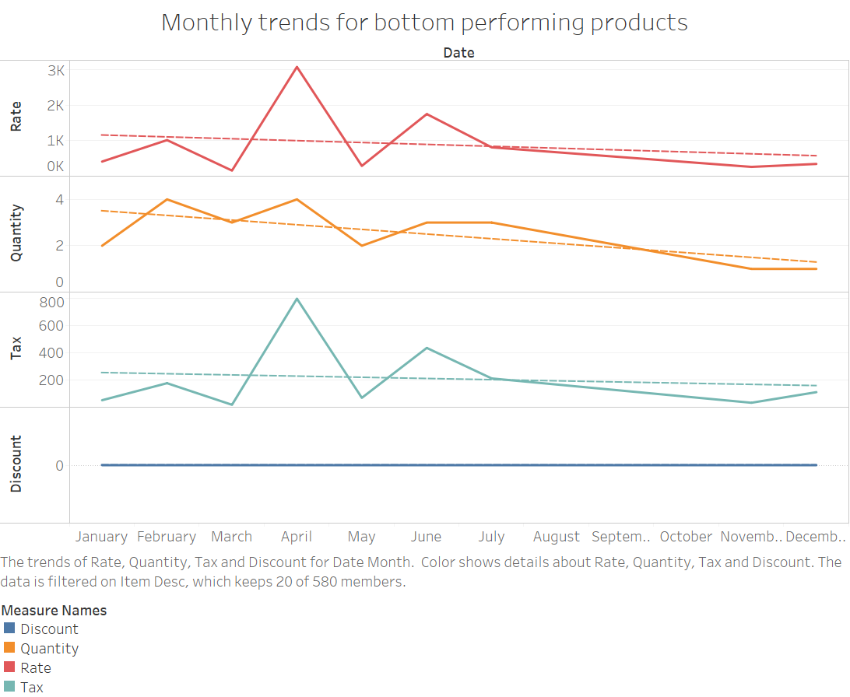
Analyzing trends associated with low performing items across months
These items have witnessed a gradual decline in the performance over the year
The quantity of these products sold has declined over the year. Even, the slight fall in prices has not been able to encourage the sale of these products. Thereby, it would be recommended to remove these products as they occupy space and capital that can be better utilized for other commodities.

Slide 14
These are bottom performing 20 products that need to removed from the menu
Item Desc
1+1 VLN CAB SAUV (BTL)
1+1 VLN SAUV BLANC (BTL)
2 AXE TWIST
2 OCEAN PINOTAGE (BTL)
4 SEASONS CLAS SYRAH(BTL)
ADD BUTTERED TOAST
AL SIKANDARI HOOKAH DOUBLE
ASH TRAYS
AVALANCHE BOWL
B1G1 4SEASON CLAS SAUV(BTL)
B1G1 4SEASON CLAS SAUV(GLS)
BEACH GREEN
BENARAS BLUE
CAPONATA
CH CRICKET NOTEBOOK
CH TIN SMALL
CHAIRMAN COOL
CLASSIC REGULAR
COUNTRY LEMONADE GLASS(HANSA)
CUTTING GLASS

Slide 15
Combos recommendations for the establishment

Slide 16
Insights based on the market basket analysis
The chart in the preceding slide depicted all the combos that can be offered with a support of 0.0005 ( accounts for 0.05% of all the transactions) and confidence of 0.2 ( means of the orders that contain LHS at least of 20% will contain RHS)
However, all the combos do not have a good support. Therefore, here are combo recommendations that have a support of 0.001 and confidence of 0.2.
Lift tells us the effectiveness of the rules and count depicts the number of transactions involving the recommendations
In the next slide, there are certain set of recommendations based strong support and confidence. These are certain recommendations offered based that have high degree of effectiveness

Slide 17
Recommendations based on strong support
Recommendations based on strong confidence

Slide 18
Recommendations based popularity and quantity of products sold
The depicted products are among some of the most widely sold products. These recommendations can be used to cross-sell and up-sell various products to boost sales during sales slump

Slide 19
R studio and tableau were used to conduct the market basket analysis and EDA
Thank you

